Slide 1
Center for Human Development’s Behavioral Health Center (CBHC)
Laying the Groundwork for
Improved Community-Based Acute Care
Christy O’Brien, LICSW, Program Director
Matt Leone, LMHC, Assistant Program Director
C

Slide 2
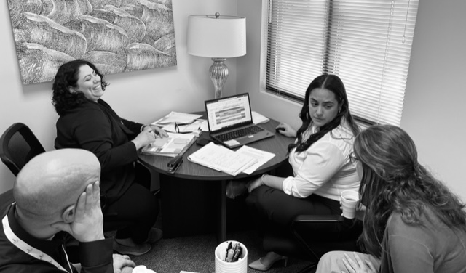
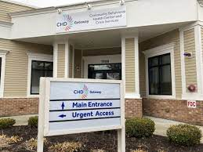
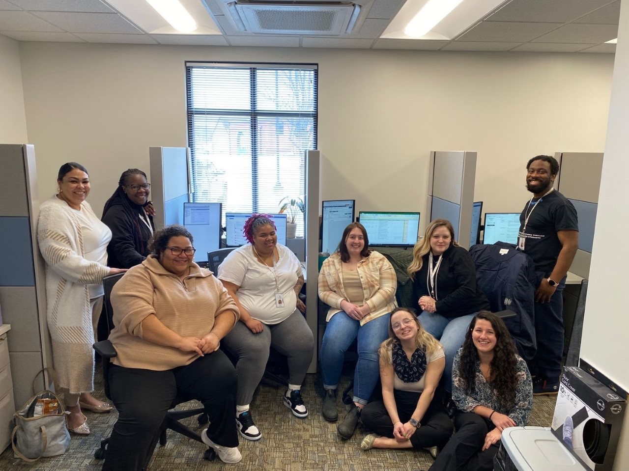

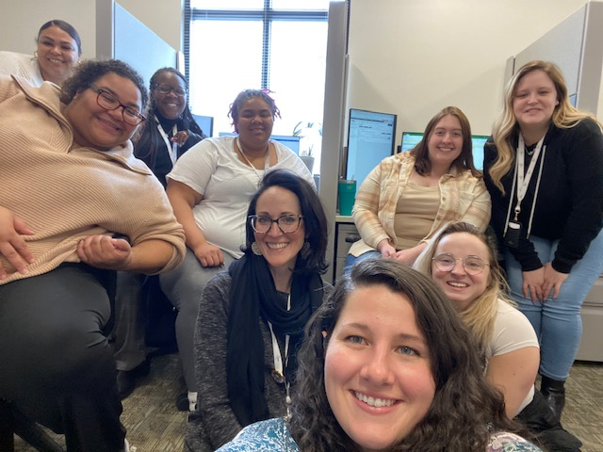
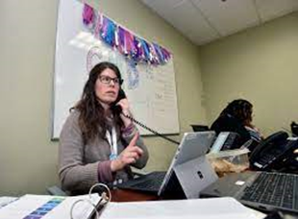
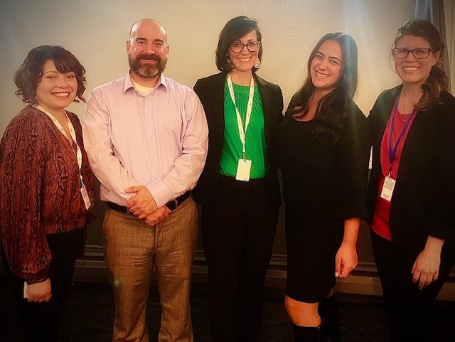

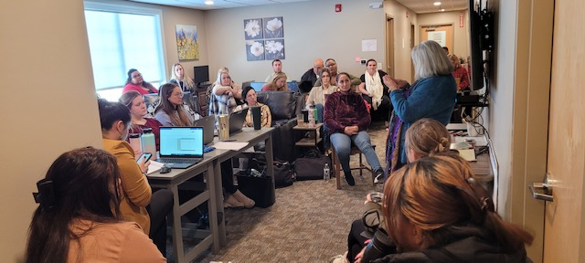
C

Slide 3
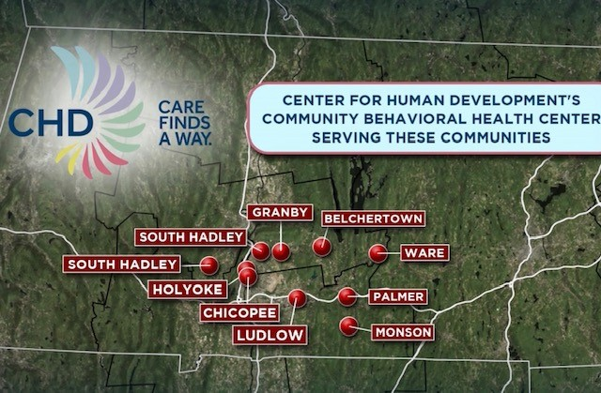
C

Slide 4
CBHCs: The Basics
Mass. EOHHS has designated providers across the state as Community Behavioral Health Centers.
  Greater spectrum of acute care services
  Reduced emergency room boarding
  Longer-term reductions in higher levels of care
Timely, high-quality and evidence-based treatment
  Routine appointments
  Urgent visits
  24/7/365 community-based crisis intervention as an alternative to hospital emergency departments.
  Access to nursing and psychiatry.
  Recovery and peer supports.
Flexible, person-centered treatment at any point of need.
M

Slide 5
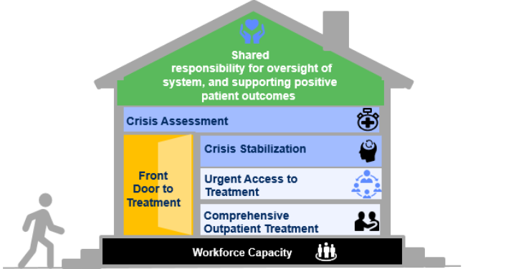
M

Slide 6

Marrying of Clinical and Psychiatric Nursing
- Interdisciplinary Intervention -
C

Slide 7
Hospital vs. CBHC
Medications (oral and IM)
Therapy/groups
24 hour monitoring
Treat & rule out unstable medical conditions
IV infusions / medications
Physical / Chemical restraints
Complex diagnostics (MRIs, XRays, Labs etc.)
Alcohol and Benzodiazepine Detox
Medications (oral and IM)
Therapy/groups
24 hour monitoring
Recovery Coach / Peer support
Stable Medical Conditions
Simple screening (glucose, pregnancy)
Opiate withdrawal & treatment
C

Slide 8
Community Outreach
Some of CHD’s CBHC Team Community Partnerships:
Hospitals
Police Departments and First responders
Jail Diversion Grants/DMH
Schools
Primary Care entities
Ambulatory care providers
Peer mental health and substance providers

Slide 9

Spectrum of Acuity
Treatment throughout the CBHC, larger CHD, and community partner continuum
Substance Use Services and MAT
Police Co-Response
Outpatient Therapy and Psychiatry
Urgent Outpatient
Crisis Intervention
Crisis Stabilization
Inpatient
School Interventions
Hospital ED Support

Slide 10
Spectrum of Acuity
Treatment throughout the CBHC, larger CHD, and community partner continuum
“I am struggling with substance use and need help.”
“I have had police interaction and they are helping me get immediate support.”
“I am stable and in insight-based therapy and psychiatry”
“I don’t feel great and I need help faster than my next OP appointment.”
“I need immediate help.”
“I need to be in a supportive, structured, 24-hour community setting.”
“I need to be in a supportive, structured, locked hospital setting.”
“I have had school staff intervention and they are helping me get immediate support.”
“I am getting checked out or admitted for life-threatening medical or psychiatric needs.”

Slide 11
Intervention
Clinical Assessment
Safety and Risk: Not actively violent. Not requiring restraint. Not able to access means.
Voluntary: Willing.
Community-Based vs. Hospital-based higher levels of care:
Nursing Assessment
Acute Conditions: Assess and treat superficial cuts.
Chronic Conditions: Assess maintenance treatment of diabetes. Assess treatment of UTI. Rule out conditions as contributors to altered mental status.
Substance Use History: Assess for signs of active use.
Psychiatric Medication: Assess current medications, methods of use, and frequency.
Team recommends crisis stabilization level of care, followed by step down to CBHC urgent outpatient and psychiatry. Nurse to nurse collaboration with primary care, and psychiatry to psychiatry.
C

Slide 12
Standard Care Provision
Mobile Crisis Intervention
Group Therapy
Nursing
Psychiatry and MAT
Adult
Community Crisis Stabilization
Police Partners
Primary Care
Outpatient Therapy
Recovery Coach
Youth Mentor & Family Partner
C

Slide 13

GATEWAY CBHC is One Door
CBHCs are not just crisis.
One access point for wide variety of needs.
Not linear.
C

